Slide 1

Web Application Security Workshop
Sun Pharmaceuticals India Ltd

Slide 2

Workshop Table Of Contents
Introduction to Web Application Security
Difference between Network Security and Application Security
Top 10 OWASP Proactive Controls 2016
Type of Attacks
What is a DDOS Layer 7 Application Attack ( Best Practices )
How to protect Application Attacks
How an Application or a Database is compromised
What is Stress Testing
What is fuzzing
Code Analysis ( Testing of Code using a Tool to check for Security threats )

Slide 3
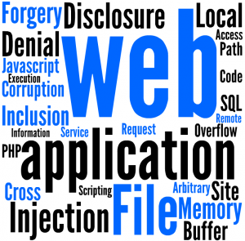
Introduction To Web Application Security
Web application security is a branch of Information Security that deals specifically with security of websites, web applications and web services. At a high level, Web application security draws on the principles of application security but applies them specifically to Internet and Web systems.
With the emergence of Web 2.0, increased information sharing through social networking and increasing business adoption of the Web as a means of doing business and delivering service, websites are often attacked directly. Hackers either seek to compromise the corporate network or the end-users accessing the website by subjecting them to drive-by downloading.
As a result, industry is paying increased attention to the security of the web applications themselves in addition to the security of the underlying computer network and operating systems.

Slide 4

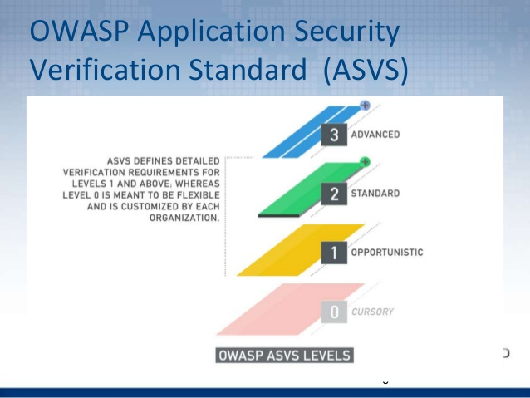
Secure web application development should be enhanced by applying security checkpoints and techniques at early stages of development as well as throughout the software development lifecycle. Special emphasis should be applied to the coding phase of development. Security mechanisms that should be used include, threat modeling, risk analysis, static analysis, digital signature, among others.
OWASP is the emerging standards body for Web application security. In particular they have published the OWASP Top 10 which describes in detail the major threats against web applications. The Web Application Security Consortium (WASC) has created the Web Hacking Incident Database and also produced open source best practice documents on Web application security.

Slide 5

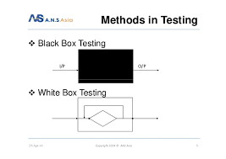
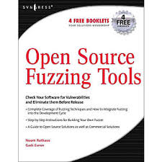
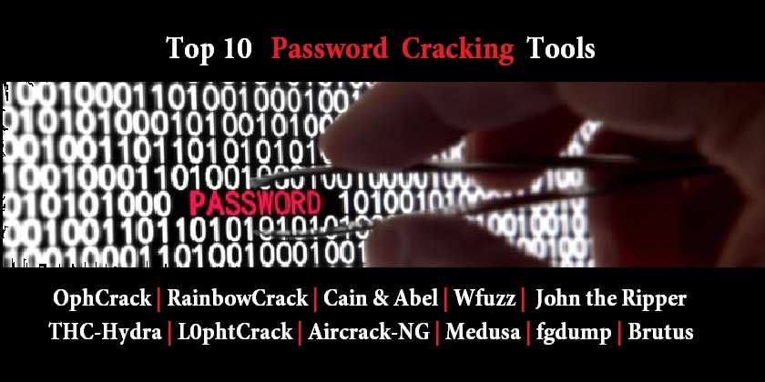
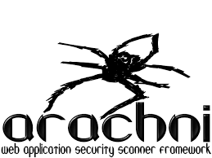
Security Technology
While security is fundamentally based on people and processes, there are a number of technical solutions to consider when designing, building and testing secure web applications. At a high level, these solutions include:
Black box testing tools such as Web application security scanners, vulnerability scanners and penetration testing software
White box testing tools such as static source code analyzers
Fuzzing Tools used for input testing
Web application security scanner (vulnerability scanner)
Web application firewalls (WAF) used to provide firewall-type protection at the web application layer
Password cracking tools for testing password strength and implementation

Slide 6
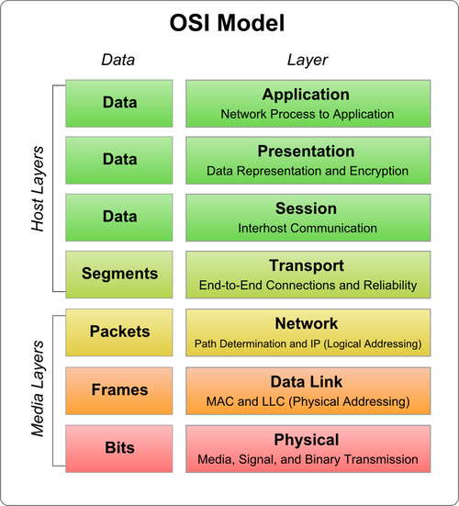
Difference between Network Security and Application Security
Network security can be either hardware based (routers with a built-in firewalls, network intrusion and detection systems) or software based. Because network security has been around for a very long time, it’s often the first thing that comes to mind when people think about security. Web application security on the other hand, is a relatively new challenge.
Theoretically Network Security lives in OSI Layer 1-6 while Application Security lives in Layer 7.
Application security works on OSI Layer 7 where normally ports 80 and 443 are open. Securing this layer is totally different aspect. The first easiest way to secure this to put your application under Reverse Proxy, and the next way to totally protect your server is through WAF.

Slide 7
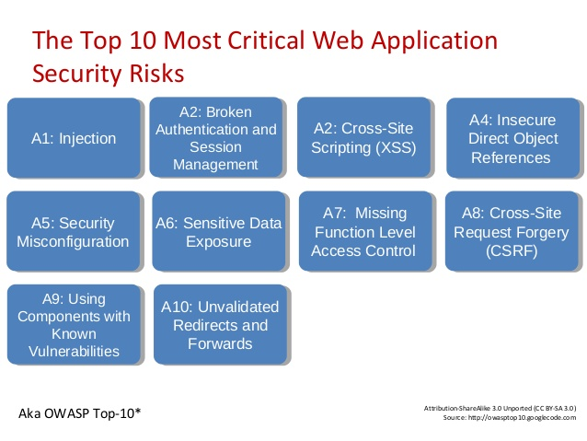

Slide 8
Type Of Attacks
Below is a small table and the % of attacks on any website of any web application server the attacker will try.
% | Type Of Attack
37% | Cross-site scripting
16% | SQL injection
5% | File Disclosure
5% | Denial-Of-Service Attack
4% | Arbitrary Code Execution
4% | Memory Corruption
4% | Cross-site-Request Forgery
3% | Data Breach (Information Disclosure)
3% | Arbitrary file inclusion
2% | Local file inclusion
1% | Remote file inclusion
1% | Buffer overflow
15% | Other, including code injection (PHP/JavaScript), etc.

Slide 9
Cross-site-scripting
Cross-site scripting (XSS) is a type of computer security vulnerability typically found in web applications. XSS enables attackers to inject client-side scripts into web pages viewed by other users. A cross-site scripting vulnerability may be used by attackers to bypass access controls such as the same-origin policy. Cross-site scripting carried out on websites accounted for roughly 84% of all security vulnerabilities documented by Symantec as of 2007.^{[1]} Their effect may range from a petty nuisance to a significant security risk, depending on the sensitivity of the data handled by the vulnerable site and the nature of any security mitigation implemented by the site's owner.
Among many other things, the ability to execute arbitrary JavaScript in another user's browser allows an attacker to perform the following types of attacks:
Cookie theft The attacker can access the victim's cookies associated with the website using document.cookie, send them to his own server, and use them to extract sensitive information like session IDs.
Keylogging The attacker can register a keyboard event listener using add EventListener and then send all of the user's keystrokes to his own server, potentially recording sensitive information such as passwords and credit card numbers.
Phishing The attacker can insert a fake login form into the page using DOM manipulation, set the form's action attribute to target his own server, and then trick the user into submitting sensitive information.

Slide 10
SQL Injection
SQL injection is a code injection technique, used to attack data-driven applications, in which nefarious SQL statements are inserted into an entry field for execution (e.g. to dump the database contents to the attacker).[SQL injection must exploit a security vulnerability in an application's software, for example, when user input is either incorrectly filtered for string literal escape characters embedded in SQL statements or user input is not strongly typed and unexpectedly executed. SQL injection is mostly known as an attack vector for websites but can be used to attack any type of SQL database.
SQL injection attacks allow attackers to spoof identity, tamper with existing data, cause repudiation issues such as voiding transactions or changing balances, allow the complete disclosure of all data on the system, destroy the data or make it otherwise unavailable, and become administrators of the database server.

Slide 11
Path Disclosure
A Path Disclosure can show you all the Files and Directories on the server for example if you find a file in the path wherein it is a PHP File which connects to the Database an e.g. file below for your reference, with this file being visible your Database might get compromised …
The leaked sourcecode of config.php:
<?php
//Hidden configuration file containing database credentials.
$hostname = 'localhost';
$username = 'root';
$password = 'owasp_fpd';
$database = 'example_site';
$connector = mysql_connect($hostname, $username, $password);
mysql_select_db($database, $connector);
?>
Here in the above case your database Username : root and the password owasp_fpd is now in the hands of the attacker and he is free now to alter, delete, add and many other things to tamper your data …

Slide 12
Arbitrary Code Execution
In computer security, "arbitrary code execution" is used to describe an attacker's ability to execute any command of the attacker's choice on a target machine or in a target process. It is commonly used in arbitrary code execution vulnerability to describe a software bug that gives an attacker a way to execute arbitrary code. A program that is designed to exploit such a vulnerability is called an arbitrary code execution exploit. Most of these vulnerabilities allow the execution of machine code and most exploits therefore inject and execute shellcode to give an attacker an easy way to manually run arbitrary commands. The ability to trigger arbitrary code execution from one machine on another (especially via a wide-area network such as the Internet) is often referred to as remote code execution.
While arbitrary code execution is most often used to inject code into a functioning system, the process has also been demonstrated by coding enthusiasts to allow the user to write code of their own in languages such as assembly, using the system itself to create and activate the produced scripts. In particular, one user managed to code and create a primitive version of the game Pong in a copy of Super Mario World using arbitrary code execution.^{[1]}
It is the most powerful effect a bug can have because it allows an attacker to completely take over the vulnerable process. From there the attacker can potentially take complete control over the machine the process is running on. Arbitrary code execution vulnerabilities are commonly exploited by malware to run on a computer without the owner's consent or by an owner to run homebrew software on a device without the manufacturer's consent.

Slide 13
Memory Corruption
Memory corruption occurs in a computer program when the contents of a memory location are unintentionally modified due to programming errors; this is termed violating memory safety. When the corrupted memory contents are used later in that program, it leads either to program crash or to strange and bizarre program behavior. Nearly 10% of application crashes on Windows systems are due to heap corruption.^{[1]}
Modern programming languages like C and C++ have powerful features of explicit memory management and pointer arithmetic. These features are designed for developing efficient applications and system software. However, using these features incorrectly may lead to memory corruption errors.
Memory corruption is one of the most intractable class of programming errors, for two reasons:
The source of the memory corruption and its manifestation may be far apart, making it hard to correlate the cause and the effect.
Symptoms appear under unusual conditions, making it hard to consistently reproduce the error.
Memory corruption errors can be broadly classified into four categories:
Using uninitialized memory: Contents of uninitialized memory are treated as garbage values. Using such values can lead to unpredictable program behavior.
Using none-owned memory: It is common to use pointers to access and modify memory. If such a pointer is a null pointer, dangling pointer (pointing to memory that has already been freed), or to a memory location outside of current stack or heap bounds, it is referring to memory that is not then possessed by the program. Using such pointers is a serious programming flaw. Accessing such memory usually causes operating system exceptions, that most commonly lead to a program crash (unless suitable memory protection software is being used).

Slide 14
Memory Corruption
Using memory beyond the memory that was allocated (buffer overflow): If an array is used in a loop, with incorrect terminating condition, memory beyond the array bounds may be accidentally manipulated. Buffer overflow is one of the most common programming flaws exploited by computer viruses, causing serious computer security issues (e.g. return-to-libc attack, stack-smashing protection) in widely used programs. In some cases programs can also incorrectly access the memory before the start of a buffer.
Faulty heap memory management: Memory leaks and freeing non-heap or un-allocated memory are the most frequent errors caused by faulty heap memory management.

Slide 15
Cross-site request Forgery
Cross-site request forgery, also known as one-click attack or session riding and abbreviated as CSRF (sometimes pronounced sea-surf) or XSRF, is a type of malicious exploit of a website where unauthorized commands are transmitted from a user that the website trusts. Unlike cross-site scripting (XSS), which exploits the trust a user has for a particular site, CSRF exploits the trust that a site has in a user's browser.

